Slide 1



Slide 2
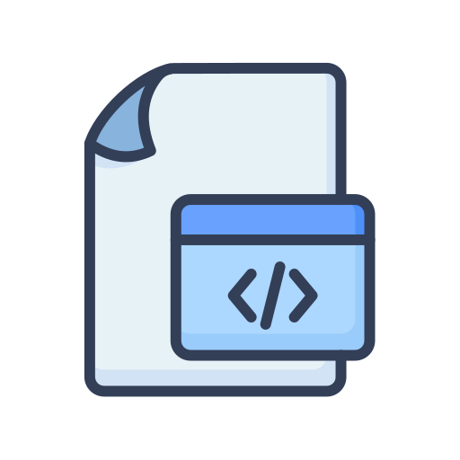


Slang IDE – How runs a Slang Program
Source Code
Pre-processor
Slang Interpreter

Slide 3
What happen in Pre-Processor
Scans the source code and merge all files that you have included with #add keyword and creates the final file.

Slide 4
What happen in Pre-Processor
main.slang
file.slang
file1.slang
Temp File

Slide 5
What happen in Pre-Processor
newFile.slang
Slang Interpreter

Slide 6

What happen in Pre-Processor
Slang Interpreter
Processing
Slang IDE

Slide 7
Tests & Q & A

